Slide 1
43
Global Ecology and Conservation Biology

Slide 2
From a biological viewpoint, diversity means different kinds of
ecosystems.
trophic levels.
species.
genotypes.
all except B
Notes:
Answer: E

Slide 3
From a biological viewpoint, diversity means different kinds of
ecosystems.
trophic levels.
species.
genotypes.
all except B
Notes:
3

Slide 4
Introduced species are sometimes a problem because they usually
are predators.
are better competitors.
displace mutualists.
exploit unused resources.
are omnivores.
Notes:
4
Answer: B

Slide 5
Introduced species are sometimes a problem because they usually
are predators.
are better competitors.
displace mutualists.
exploit unused resources.
are omnivores.
Notes:
5

Slide 6
Many endangered or extinct species live in freshwater habitats, such as along the Mississippi River. Eutrophication has been one major source of freshwater destruction and damage. Since nitrogen is a major contributor to eutrophication, one good solution would be to
breed varieties of duckweed that absorb lots of phosphorus.
fertilize cornfields during the summer instead of in spring.
prevent runoff of nitrogen fertilizers from agricultural land.
require all wastewater dumped in the Mississippi River to go through a wastewater treatment facility first.
build more levees so the river runs to the Gulf of Mexico faster.
Notes:
6
Answer: C

Slide 7
Many endangered or extinct species live in freshwater habitats, such as along the Mississippi River. Eutrophication has been one major source of freshwater destruction and damage. Since nitrogen is a major contributor to eutrophication, one good solution would be to
breed varieties of duckweed that absorb lots of phosphorus.
fertilize cornfields during the summer instead of in spring.
prevent runoff of nitrogen fertilizers from agricultural land.
require all wastewater dumped in the Mississippi River to go through a wastewater treatment facility first.
build more levees so the river runs to the Gulf of Mexico faster.
Notes:
7

Slide 8
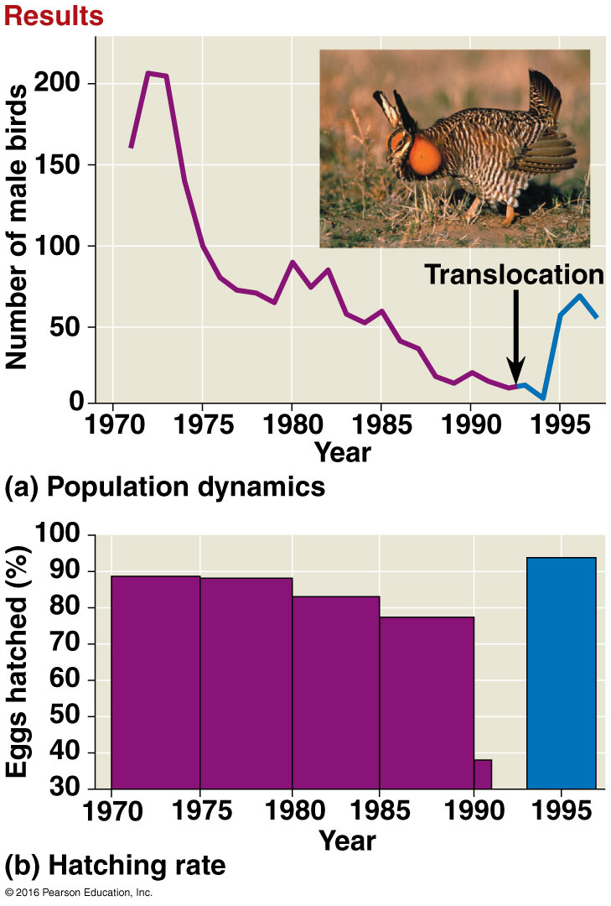
The first figure shown below shows the Illinois prairie chicken population between 1970 and 2000. The second figure shows that egg viability declined sharply as the number of males decreased. However, the text says that there used to be millions of prairie chickens in Illinois in the 19th century. The graph doesn’t go back that far, but the most important reason for the large reduction in prairie chickens between 1850 and 1950 was
a skewed sex ratio.
habitat loss.
an increase in feral dogs.
a lack of genetically diverse males.
that the population fell below its MVP.
Notes:
8
Answer: B

Slide 9
The first figure shown below shows the Illinois prairie chicken population between 1970 and 2000. The second figure shows that egg viability declined sharply as the number of males decreased. However, the text says that there used to be millions of prairie chickens in Illinois in the 19th century. The graph doesn’t go back that far, but the most important reason for the large reduction in prairie chickens between 1850 and 1950 was
a skewed sex ratio.
habitat loss.
an increase in feral dogs.
a lack of genetically diverse males.
that the population fell below its MVP.
Notes:
9

Slide 10
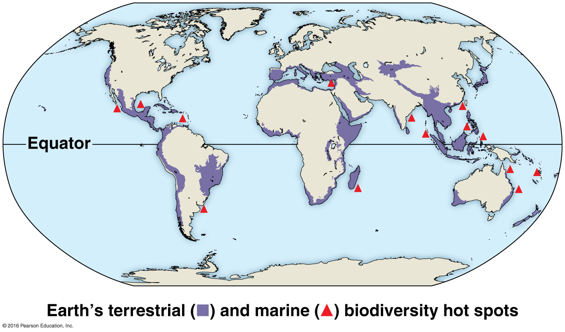
The map below shows Earth’s biodiversity hot spots. There are several interesting patterns here, one of which is that there are no biodiversity hot spots
north of the equator.
on islands.
in Europe.
in areas with lots of people.
near the poles.
Notes:
10
Answer: E

Slide 11
The map below shows Earth’s biodiversity hot spots. There are several interesting patterns here, one of which is that there are no biodiversity hot spots
north of the equator.
on islands.
in Europe.
in areas with lots of people.
near the poles.
Notes:
11

Slide 12
Costa Rica has established an extensive network of national parks and buffer zones to protect its biodiversity. However, a recent study showed that habitat loss outside these zones is significant. This shows that
Costa Rica is too small.
habitat zones don’t work.
biodiversity can take care of itself.
protecting biodiversity is difficult.
the laws need to be enforced better.
Notes:
12
Answer: D

Slide 13
Costa Rica has established an extensive network of national parks and buffer zones to protect its biodiversity. However, a recent study showed that habitat loss outside these zones is significant. This shows that
Costa Rica is too small.
habitat zones don’t work.
biodiversity can take care of itself.
protecting biodiversity is difficult.
the laws need to be enforced better.
Notes:
13

Slide 14
We are concerned about carbon dioxide increases in our global atmosphere. Imagine that we planted trees to grow into a forest over a large area, perhaps the size of Australia. Would this be a good way to stop or slow the accumulation of carbon dioxide in the atmosphere?
No, because plants release carbon dioxide via photosynthesis.
Yes, because the trees would convert carbon dioxide into wood.
Perhaps, but when the trees died and decayed, the carbon dioxide would be returned to the atmosphere.
No; it is unlikely that plants could make much difference in global air concentrations.
Yes, because it would show the world we were serious about stopping global warming.
Notes:
14
Answer: C

Slide 15
We are concerned about carbon dioxide increases in our global atmosphere. Imagine that we planted trees to grow into a forest over a large area, perhaps the size of Australia. Would this be a good way to stop or slow the accumulation of carbon dioxide in the atmosphere?
No, because plants release carbon dioxide via photosynthesis.
Yes, because the trees would convert carbon dioxide into wood.
Perhaps, but when the trees died and decayed, the carbon dioxide would be returned to the atmosphere.
No; it is unlikely that plants could make much difference in global air concentrations.
Yes, because it would show the world we were serious about stopping global warming.
Notes:
15

Slide 16
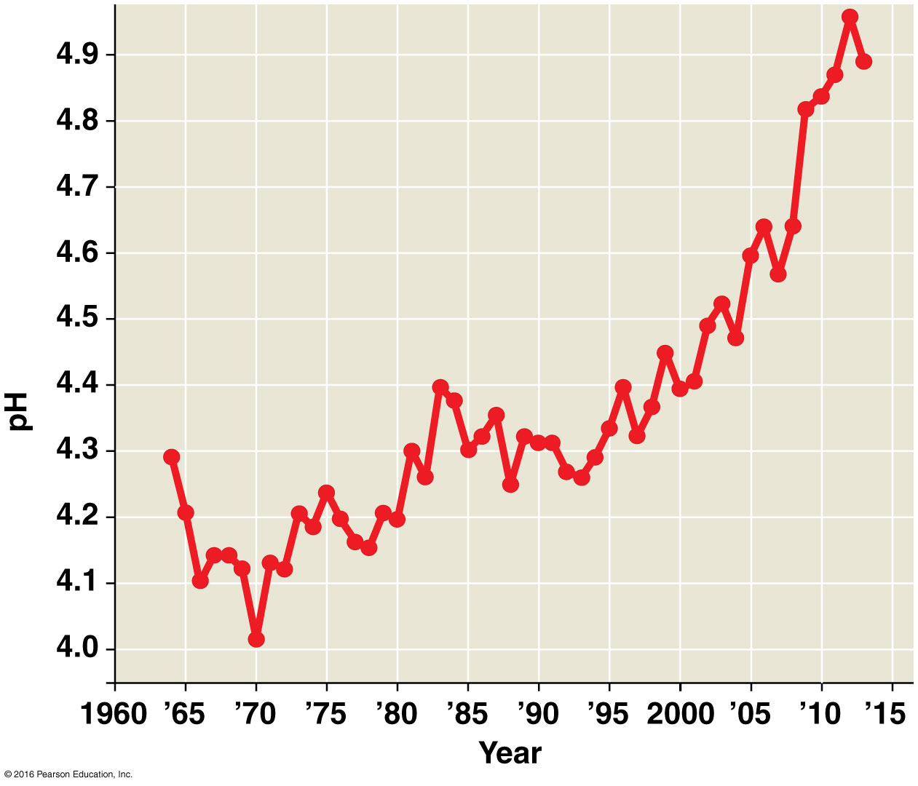
The graph below shows carbon dioxide levels and average global temperatures from 1958 to 2015. We can conclude several things from the graph, including which of the following?
Over the nearly 60 years of data, there appears to be a positive correlation between carbon dioxide levels and average global temperatures.
Over the nearly 60 years of data, carbon dioxide concentrations have increased.
Over the nearly 60 years of data, average global temperatures have increased.
There was more variation in temperature than in carbon dioxide concentrations.
All of the above are correct.
Notes:
16
Answer: E

Slide 17
The graph below shows carbon dioxide levels and average global temperatures from 1958 to 2015. We can conclude several things from the graph, including which of the following?
Over the nearly 60 years of data, there appears to be a positive correlation between carbon dioxide levels and average global temperatures.
Over the nearly 60 years of data, carbon dioxide concentrations have increased.
Over the nearly 60 years of data, average global temperatures have increased.
There was more variation in temperature than in carbon dioxide concentrations.
All of the above are correct.
Notes:
17

Slide 18
Which of the following is the biggest reason for the massive decline in biodiversity?
habitat destruction
introduced species
overhunting
disruption of the food chain
Notes:
18
Answer: A. Habitat destruction has the greatest effect since it is so widespread, and it is also related to climate change.

Slide 19
Which of the following is the biggest reason for the massive decline in biodiversity?
habitat destruction
introduced species
overhunting
disruption of the food chain
Notes:
19

Slide 20
Which of the following is an example of biological magnification?
increased productivity due to fertilizer runoff
toxins accumulating in tissues in higher trophic levels
creating reserves and parks to protect wildlife
linking together a previously fragmented habitat
Notes:
20
Answer: B. As a toxin is ingested and stored in the fatty tissues of organisms at the bottom of the food chain, those organisms are ingested, and their toxins accumulate in the tissues of their predator. This continues until at the top of the food chain, you have the highest toxin concentrations.

Slide 21
Which of the following is an example of biological magnification?
increased productivity due to fertilizer runoff
toxins accumulating in tissues in higher trophic levels
creating reserves and parks to protect wildlife
linking together a previously fragmented habitat
Notes:
21

Slide 22
Which of these is true about an endangered species?
An endangered species is in danger of extinction throughout all or much of its range.
An endangered species is in less danger of extinction than a threatened species.
A species is classified as threatened but not endangered unless it is endangered throughout its entire range.
Endangered species are only those that may become extinct due to human activities.
Notes:
22
Answer: A. An endangered species is in danger of extinction throughout all or much of its range.

Slide 23
Which of these is true about an endangered species?
An endangered species is in danger of extinction throughout all or much of its range.
An endangered species is in less danger of extinction than a threatened species.
A species is classified as threatened but not endangered unless it is endangered throughout its entire range.
Endangered species are only those that may become extinct due to human activities.
Notes:
23

Slide 24
All of the following are benefits of species and genetic diversity except
disease resistance.
anti-cancer properties.
enzymes with unique properties.
water purification.
Notes:
24
Answer: D. Water purification is an ecosystem service.

Slide 25
All of the following are benefits of species and genetic diversity except
disease resistance.
anti-cancer properties.
enzymes with unique properties.
water purification.
Notes:
25

Slide 26
Which of the following are threats to biodiversity?
habitat loss
introduced species
overharvesting
global change
all of the above
Notes:
26
Answer: E

Slide 27
Which of the following are threats to biodiversity?
habitat loss
introduced species
overharvesting
global change
all of the above
Notes:
27

Slide 28
Which of the following statements about the evolutionary implications of small population size is false?
Small populations are not doomed by low genetic diversity.
Small populations are vulnerable to inbreeding and genetic drift.
The effects of loss of genetic variation decrease along with population size.
The northern elephant seal population rebounded from 20 to 150,000 individuals since the 1890s.
Notes:
28
Answer: C. The effects of loss of genetic variation decrease as population size decreases

Slide 29
Which of the following statements about the evolutionary implications of small population size is false?
Small populations are not doomed by low genetic diversity.
Small populations are vulnerable to inbreeding and genetic drift.
The effects of loss of genetic variation decrease along with population size.
The northern elephant seal population rebounded from 20 to 150,000 individuals since the 1890s.
Notes:
29

Slide 30
If the Yellowstone grizzly bear population is about 1,000 and only 292 of the males and 312 of the females are breeding, what percentage of the total population is N_{e} ?
40%
60%
6%
25%
none of the above
Notes:
30
Answer: B. Calculation: [(4)(312)(292)/292 + 312)]/1,000 = 60% (0.6)

Slide 31
If the Yellowstone grizzly bear population is about 1,000 and only 292 of the males and 312 of the females are breeding, what percentage of the total population is N_{e} ?
40%
60%
6%
25%
none of the above
Notes:
31

Slide 32
Which of the following is an incorrect statement about edge-adapted species?
Edge-adapted species gain resources from both adjacent areas.
Edge-adapted species include white-tailed deer.
Edge-adapted species require specific habitats for certain seasonal behaviors.
Edge-adapted species’ populations decline more rapidly in fragmented habitats than non-edge-adapted species’ populations.
Notes:
32
Answer: D. Edge-adapted species’ populations decline less rapidly in fragmented habitats than non-edge-adapted species’ populations.

Slide 33
Which of the following is an incorrect statement about edge-adapted species?
Edge-adapted species gain resources from both adjacent areas.
Edge-adapted species include white-tailed deer.
Edge-adapted species require specific habitats for certain seasonal behaviors.
Edge-adapted species’ populations decline more rapidly in fragmented habitats than non-edge-adapted species’ populations.
Notes:
33

Slide 34
Why are biodiversity hot spots difficult to identify?
A biodiversity hot spot is a relatively small area.
A hot spot for one taxonomic group may not be a hot spot for some other taxonomic group.
Hot spots for 70% of bird species make up 98% of Earth’s land area.
Most biodiversity hot spots are aquatic.
Notes:
34
Answer: B. A problem is that a hot spot for one taxonomic group may not be a hot spot for some other taxonomic groups.

Slide 35
Why are biodiversity hot spots difficult to identify?
A biodiversity hot spot is a relatively small area.
A hot spot for one taxonomic group may not be a hot spot for some other taxonomic group.
Hot spots for 70% of bird species make up 98% of Earth’s land area.
Most biodiversity hot spots are aquatic.
Notes:
35

Slide 36
Which of the following is not a solution to climate change?
using energy more efficiently
replacing fossil fuels with renewable solar and wind power
paying countries to cut forests
stabilizing CO₂ emissions
changes to personal lifestyles and industrial processes
Notes:
36
Answer: C. Paying countries not to cut forests could decrease the rate of deforestation and slow the buildup of greenhouse gases.

Slide 37
Which of the following is not a solution to climate change?
using energy more efficiently
replacing fossil fuels with renewable solar and wind power
paying countries to cut forests
stabilizing CO₂ emissions
changes to personal lifestyles and industrial processes
Notes:
37

Slide 38
The rate of growth of the global population
peaked in 2014.
is projected to be half a percent by 2050.
shows how the human population is growing more quickly than expected in exponential growth.
was unaffected by voluntary population control.
both B and C
Notes:
38
Answer: E. The annual rate of increase of the human population peaked in 1962 and is expected to be 0.5% by 2050. Fundamental shifts occurred in population dynamics due to voluntary population control.

Slide 39
The rate of growth of the global population
peaked in 2014.
is projected to be half a percent by 2050.
shows how the human population is growing more quickly than expected in exponential growth.
was unaffected by voluntary population control.
both B and C
Notes:
39

